Slide 1


Athena-CTI-LLM Overview aka Glaukopis
Foundational Cyber Threat Intelligence Language Model for the next generation SOC
© 2025 Athena Software Group Inc. Confidential & Proprietary. Do not distribute without express permission.
By Peter J Worth Jr
Founder, President & CEO
Athena Security Group LLC

Slide 2
01
Introduction: On Athena
Athena CTI LLM Overview
02
CTI-LLM Design: Instruction Finetuning
03
LLM Testing & Lifecycle Management
04
Summary

Slide 3
Athena Security Group
Who we are and why we are different

Slide 4
Athena Security Group
A company founded under the principles of integrating Cyber Security best practices, high end custom enterprise software and artificial intelligence (LLMs).
Athena Software Group brings together some of the best minds in computer science, cyber defense and SaaS to design solutions specifically for application service providers.
We take a fully integrated and analytical approach to Cyber Security defense, knowing through experience that the best Cyber Defense strategies arise from providing the best analysts with the best tools from within a fully integrated cyber security infrastructure that is informed by the latest cyber and t
We intend to set a new bar in Cyber defense by providing tools along the entire Cyber defense stack which are fully integrated with Cyber specific trained LLMs that both understand the global threat landscape AND are informed by the technical specifications which underpin the application specific infrastructure environment facilitating higher quality, more rapid and informed outcomes with respect to threat and anomaly detection, response management, vulnerability management and compliance.

Slide 5



The Cybersecurity Challenge
Proliferation of security tools
Siloed data and lack of integration
Overwhelmed security teams
Organizations employ a variety of security tools, such as firewalls, web application firewalls (WAFs), intrusion detection systems (IDS), and endpoint detection and response (EDR) solutions, leading to a complex and fragmented security landscape.
Security data is often trapped in individual tools, making it difficult to gain a comprehensive view of the threat landscape and hindering effective threat detection and response.
Security teams struggle to correlate and analyze data from multiple disparate tools, leading to increased workloads and delays in identifying and addressing security incidents.
The fragmentation of security tools and siloed data across an organization's network infrastructure hinders the ability to detect, analyze, and respond to threats in a timely and effective manner, presenting a significant challenge in today's evolving cybersecurity landscape.

Slide 6
Key Components of Athena’s Fully-Integrated Cyber Defense Solution
Web Application Firewall (WAF)
  Protects web applications from common web-based attacks by inspecting and filtering incoming traffic, enforcing security policies, and detecting and mitigating threats such as SQL injection, cross-site scripting, and application-level DDoS attacks.
Firewall
  Provides a perimeter defense by controlling and monitoring the incoming and outgoing network traffic based on predetermined security rules, protecting the network from unauthorized access and preventing the spread of malware and other threats.
Network Intrusion Detection System (NIDS)
  Monitors network traffic for signs of malicious activity, such as unauthorized access attempts, network-based attacks, and suspicious data patterns, and alerts security teams to potential threats in real-time.
Endpoint Detection and Response (EDR)
  Continuously monitors and analyzes activity on individual endpoints (e.g., laptops, desktops, servers) to detect, investigate, and respond to advanced threats, including malware, zero-day attacks, and suspicious user behavior.
Security Information and Event Management (SIEM)
  Collects, analyzes, and correlates security-related data from various sources across the network, providing a centralized view of the organization's security posture and enabling faster detection, investigation, and response to security incidents.

Slide 7
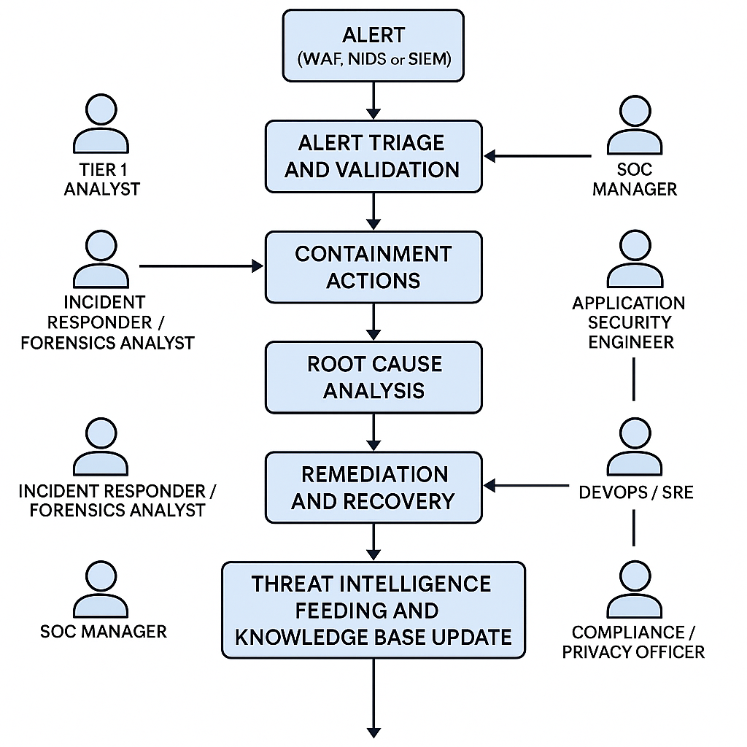
We have potential threats originating from multiple systems, each of which requires its own identity management system (potentially integrated but not so simple), its own interface and analytics, and each of which requires in depth understanding of the system in question and the specific domain being protected.

Slide 8
The Value of an Integrated Approach
Enhanced Threat Detection
Improved Threat Analysis
Streamlined Remediation
Consolidating security tools and data across the network allows for a more comprehensive view of potential threats, enabling faster and more accurate detection of anomalies and suspicious activities.
By integrating data from various security components, security teams can analyze threat patterns and indicators more effectively, leading to better informed decision-making and more efficient incident response.
An integrated approach facilitates the coordination of remediation efforts, allowing security teams to respond to threats quickly and consistently across the entire network infrastructure.
Reduced Operational Overhead
Enhanced Visibility and Reporting
Consolidating security tools and data eliminates the need for manual correlation and analysis across disparate systems, reducing the time and resources required for security operations.
Integrated security solutions provide a holistic view of the organization's security posture, enabling more comprehensive and meaningful reporting to stakeholders and decision-makers.

Slide 9



AI Enablement
Athena Software Group is at the forefront of integrating advanced AI capabilities into cybersecurity strategy and operations, helping organizations transition from reactive to proactive security postures.
Threat Intelligence Enrichment
Anomaly Detection & Behavior Analysis
Automated Response Orchestration
Our AI systems analyze global threat data from multiple sources, correlating it with your specific environment to provide contextualized intelligence about emerging threats relevant to your industry and technology stack.
Advanced machine learning algorithms establish baselines of normal behavior across networks, systems, and users, identifying subtle deviations that may indicate compromise before traditional detection methods.
AI-powered playbooks automate incident response workflows, reducing mean time to remediate (MTTR) by coordinating actions across security tools while maintaining human oversight for critical decisions.
Our AI solutions are designed to augment human expertise, not replace it. We focus on reducing alert fatigue, accelerating analysis, and enabling security teams to focus on strategic priorities while machines handle repetitive tasks.

Slide 10
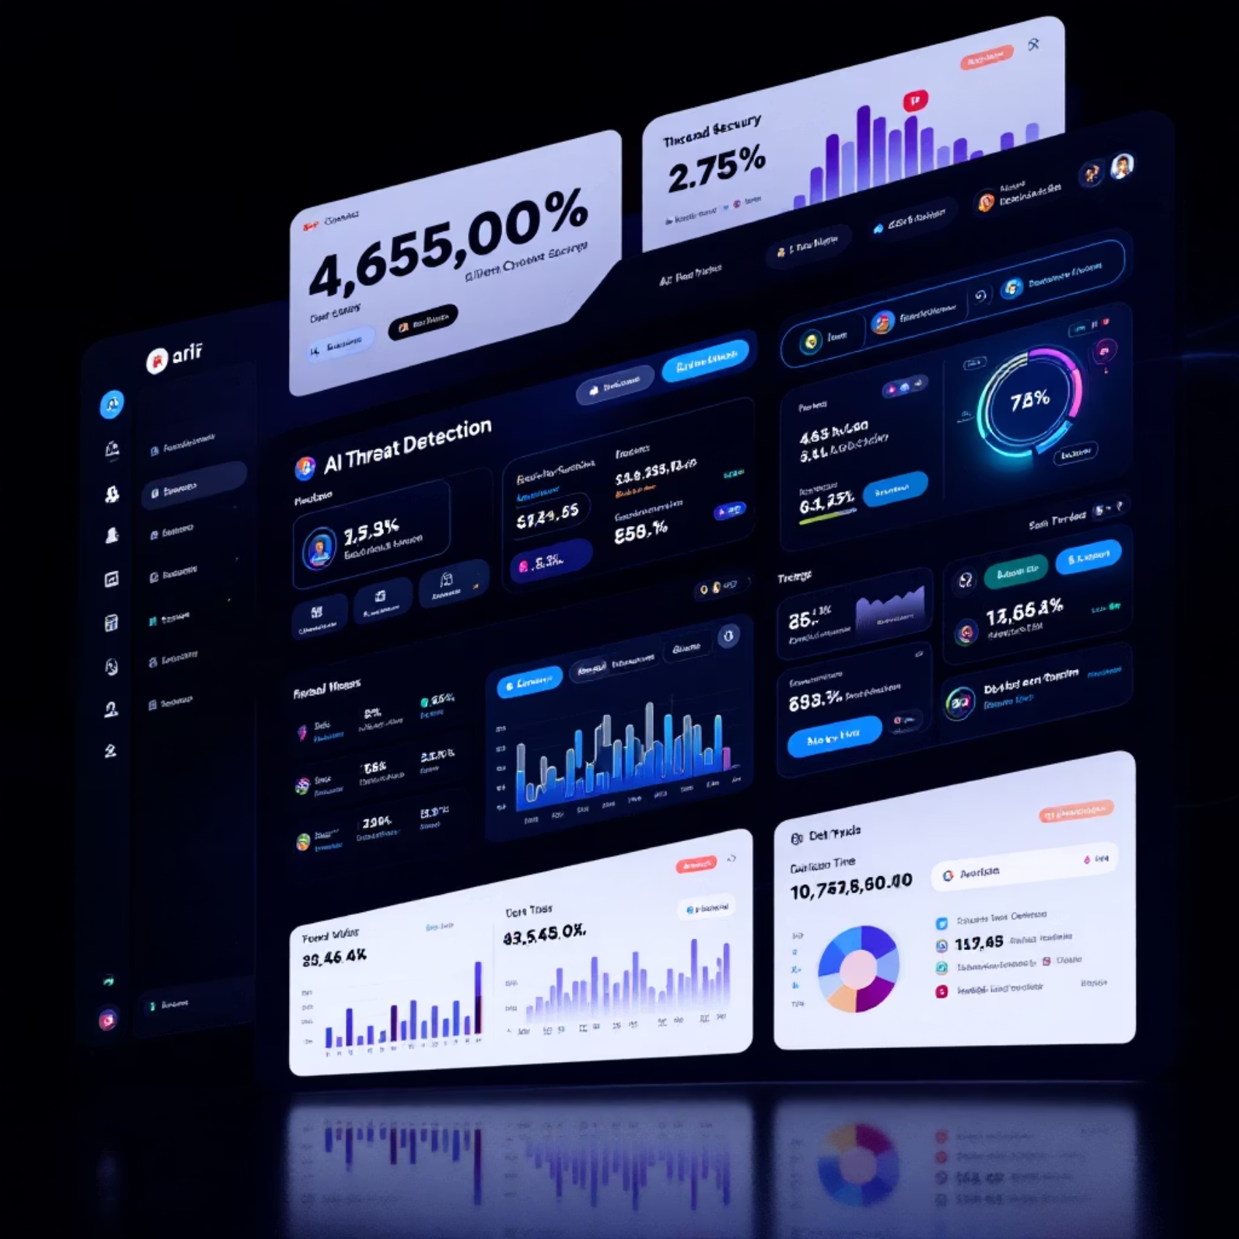
Enterprise Grade Security
Integrated AI-Enabled Cybersecurity Platform
Our flagship Enterprise Security Suite delivers comprehensive protection through a unified platform that eliminates security gaps and simplifies management. Powered by advanced artificial intelligence, the suite continuously learns and adapts to emerging threats.
XDR (Extended Detection and Response)
Detect and respond to threats across endpoints, networks, cloud workloads, and applications with correlated security data and automated response capabilities.
WAF & Firewall Protection
Defend web applications and network perimeters with intelligent filtering that blocks malicious traffic while allowing legitimate users to access critical resources.
SIEM & NIDS Integration
Centralize security event monitoring and network intrusion detection to identify suspicious patterns and provide complete visibility across your infrastructure.
Advanced CTI LLM Integration
Built in Integration with the industries most advanced Threat Intelligence LLM (built with Flashpoint Intelligence)

Slide 11
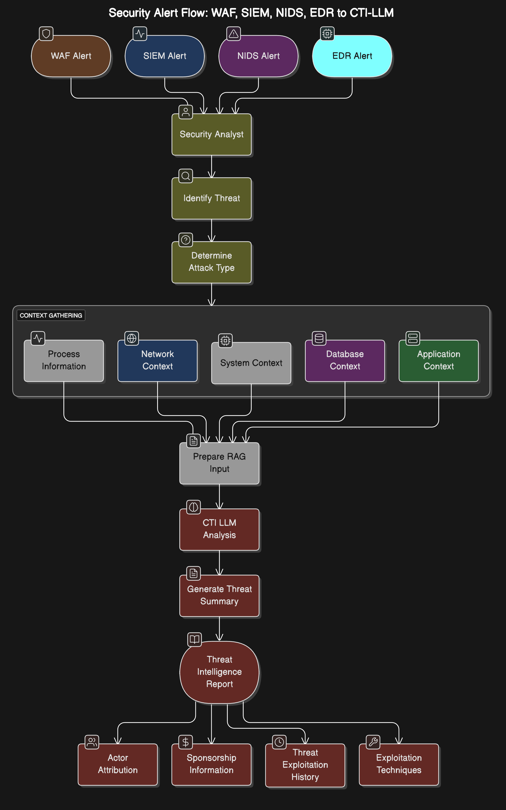
Stop the madness!
Consolidate threat sources and normalize the data. Feed into CTI-LLM that collates the detailed technical info with best-in-class industry knowledge (Ignite).
Enter Athena…

Slide 12
Product Roadmap
2025
Q1-Q2 2026
Q3-Q4 2026
2027 ->
ALPHA / BETA
Gamma (GA)
DELTA
EPSILON
Entity & Team Build.
Site setup and Branding
Proof of Concept
Initial Round Funding
SaaS Operations
BETA Product Delivery
Go to Market Strategy
Sales Team & Pipeline
SOC 2 Certification
Promachos GA
CTI-LLM GA
Customer Adoption
SOC Operations
Second Round Funding
Generation II CTI-LLM
Promachos V2.0
Partner Channel Development
Sales & Marketing Scale
Support & Services Teams
Market Disruption
Advanced AI Capabilities
Extended Integration Footprint
Regulated Companies
European Expansion
Release Early & Often
Engage Design Partners Early for market fit and revenue alignment
Raise funds only as necessary
Notes:
https://pixabay.com/en/entrepreneur-startup-start-up-man-593377/

Slide 13
Athena-CTI-LLM
Using CTI Data to Instruction Fine Tune a State of the Art CTI LLM

Slide 14
Foundational Use Cases for Cyber Security Language Models
1. Threat Detection and Anomaly Identification
LLMs can analyze extensive logs, network events, and telemetry data, recognizing subtle patterns indicative of cyber threats or anomalies. They provide contextual understanding of suspicious activity, correlating seemingly unrelated events to identify potential breaches or attacks.
2. Security Incident Response Automation
Automating responses to standard security incidents by interpreting alerts, analyzing context, and suggesting or executing initial remediation steps. Streamlining the triage process to quickly prioritize critical threats based on context derived from past incidents.
3. Vulnerability Assessment and Management
Parsing security bulletins, advisories, and CVE databases to summarize and highlight critical vulnerabilities relevant to an organization's infrastructure. Generating actionable mitigation strategies and prioritization recommendations tailored to the organization's specific technologies and risk profile.
4. Phishing and Social Engineering Detection
Identifying suspicious patterns in emails, text messages, and other communication platforms by leveraging natural language understanding to detect phishing, impersonation, or manipulative techniques. Educating users by generating realistic phishing simulations or context-aware cybersecurity training content.
5. Cybersecurity Documentation and Compliance Automation
Generating compliance reports, incident documentation, and audit logs automatically, reducing the manual burden associated with regulatory requirements (e.g., GDPR, NYSDFS 23 NYCRR 500).Assisting in the interpretation of regulatory texts, summarizing complex cybersecurity requirements, and suggesting compliance actions.
6. Intelligent Threat Intelligence
Parsing vast amounts of threat intelligence data to provide concise, actionable insights tailored to an organization's unique threat landscape. Automatically generating intelligence reports or briefings about emerging threats and their implications for the organization.
7. Cybersecurity Assistant (Chatbot/Virtual Analyst)
Serving as a first-line assistant that provides cybersecurity support, answering questions about policies, procedures, recent threats, or incident response guidelines. Assisting cybersecurity analysts by summarizing logs, incidents, or threat intelligence data to expedite informed decision-making.
8. Code and Software Security Analysis
Reviewing code repositories, documentation, and logs to identify potential security weaknesses, such as insecure coding patterns, hardcoded credentials, or risky configuration settings. Suggesting secure coding practices and generating contextual remediation steps.
9. Enhanced SIEM and Log Analysis
Integrating LLMs with Security Information and Event Management (SIEM) platforms to provide enhanced semantic understanding of security logs, correlate events, and reduce false positives through natural language analysis. Improving root-cause analysis by interpreting event logs and contextualizing security events.
10. Retrieval-Augmented Generation (RAG) for Security
Employing RAG models to access up-to-date cybersecurity knowledge bases or internal documentation, providing timely, accurate, and contextually relevant answers during security incidents or routine operations.
Threat intelligence application is the target for first phase, with incident response, compliance automation, analysts support and RAG integration (1, 2, 5, 7 and 10) as potential targets thereafter. Models must be trained on Cyber security data (public + private) and then plugged into the environment for proper contextualization and customization of output

Slide 15
Cyber Security Language Models
Model Name | Introduced | Developer(s) | Base Model | Training Methodology | Targeted Domains
CyberPal.AI | Aug-24 | Matan Levi et al. | Not specified | Instruction tuning with SecKnowledge dataset; evaluated using SecKnowledge-Eval benchmark | Threat hunting, malware analysis, vulnerability assessment, incident response
Llama-Primus | Feb-25 | Trend Micro AI Lab | Llama-3.1-8B-Instruct | Continual pretraining on cybersecurity corpus; instruction fine-tuning with curated QA tasks | Cyber threat intelligence, vulnerability classification, security certification preparation
SecBERT | 2022 | jackaduma | BERT | Pretrained from scratch on cybersecurity texts including APTnotes, Stucco-Data, CASIE, and SemEval-2018 Task 8; custom vocabulary | Threat intelligence, NER, text classification, semantic understanding, Q&A in cybersecurity context
SecureBERT | 2022 | Ehsan Aghaei et al. (UNC Charlotte) | BERT | Continual pretraining with customized tokenizer on large corpus of cybersecurity text | Cyber threat intelligence, cyber automation, phishing detection, code and malware analysis, intrusion detection
CTI-BERT | Dec-23 | IBM T.J. Watson Research Center | BERT | Pretrained from scratch on high-quality cybersecurity corpus containing CTI reports and publications | Cyber threat intelligence extraction, security entity (IoCs) extraction, attack technique (TTPs) classification
SecurityLLM | Jan-25 | ZySec-AI | Zephyr-7b-beta | Direct Preference Optimization (DPO) training across 30+ security domains | Threat analysis, compliance verification, security architecture reviews, SOC operations, risk management
SecurityBERT | Jun-23 | Mohamed Amine Ferrag et al. | BERT | Privacy-preserving encoding technique (PPFLE) combined with Byte-level Byte-Pair Encoder (BBPE) Tokenizer; trained on IoT data | Cyber threat detection in IoT/IIoT devices
Variety of models have been introduced with a broad range of test methodologies and applications. Technology development and adoption is still in its infancy.

Slide 16
Evaluating the Performance of Cyber Security LLMs
Benchmarks for Cyber Security Language Models
Benchmark | Organization / Authors | Open Source | Cybersecurity Domain | Key Tasks | Introduced In
CTIBench | University of Waterloo & AI4Sec | Yes (GitHub, Hugging Face) | Threat Intelligence, Vulnerability Analysis, Threat Attribution | CTI-MCQ, CTI-RCM, CTI-VSP, CTI-TAA | Jul-24
SecKnowledge-Eval | CyberPal.AI (Authors of SecKnowledge Paper) | No (Contact authors) | Instruction Following, Threat Analysis, Security Reasoning | Threat/attack pattern understanding, contextual security tasks | Aug-24
CyberSecEval 2 | Meta AI | No | Offensive & Defensive Cybersecurity, LLM Risk Assessment | Malicious instruction handling, threat detection, security training evaluation | Apr-24
Sophos Benchmark Suite | Sophos AI | No | SOC Operations, Incident Handling | Incident summarization, SQL generation, severity rating | Mar-24
SECURE | Rochester Institute of Technology | Partially (some datasets) | ICS Security, Threat Reasoning | Knowledge extraction, understanding, reasoning in ICS scenarios | May-24
Cybench | CTF Community Researchers | Limited (some CTF challenges) | Offensive Security, Exploit Development | CTF task solving, vulnerability discovery, exploit execution | Jun-24
Evaluation of open-source benchmarks, applicability to threat intelligence specifically and potentially expanding and creating our own benchmark that speaks to the capabilities around Flashpoint Threat Intel specifically.

Slide 17
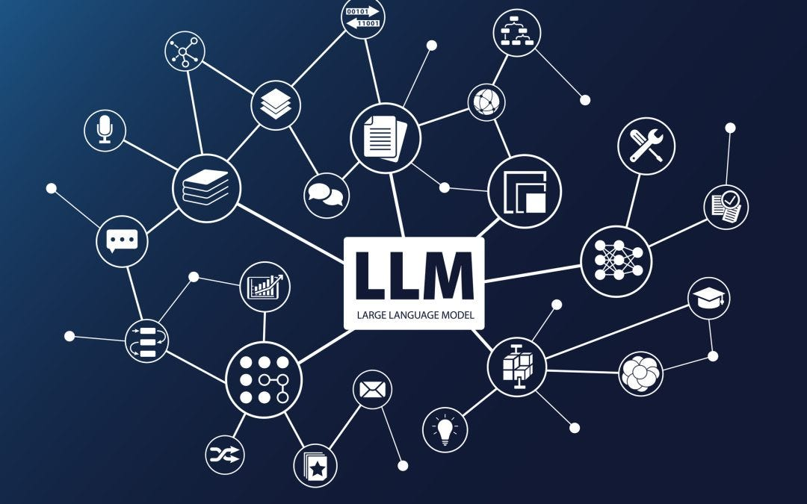
Athena’s Cyber Threat Intelligence LLM
Injecting AI directly into the Threat Response Pipeline
Cyber Threat Intelligence (CTI) is the cornerstone of effective cyber security. It involves the systematic collection, analysis, and dissemination of information about existing and potential threats to an organization’s digital infrastructure.
CTI provides crucial insights into attacker tactics, techniques, and procedures (TTPs), vulnerabilities, and emerging threats. Armed with this intelligence, organizations can make informed decisions, strengthen their defenses, and mitigate risks.
The expanding use of LLM in cyber security is bringing substantial changes to the CTI landscape. These models excel at processing unstructured data, which constitutes a significant portion of threat intelligence. By ingesting massive volumes of security reports, blogs, news articles, social media posts, and technical documents, LLMs can extract relevant information, identify patterns, and uncover hidden connections.
This ability to sift through mountains of data and distill actionable insights is invaluable for security analysts, who can now leverage more diverse and comprehensive intelligence sources than ever before.
The integration of LLM threat intelligence solutions into standard workflows offers a multitude of benefits:
Enhanced threat detection and prediction. Language models can analyze historical attack data to identify patterns and trends, enabling the proactive detection and prediction of future threats. This early warning system allows organizations to take preventative measures before attacks occur. In fact, such models can identify fourteen (14) different types of attacks with an overall accuracy of 98%.
Accelerated incident response. In the aftermath of a security breach, AI systems rapidly analyze incident data to determine the scope of the attack, identify the root cause, and recommend remediation strategies. This speeds up incident reaction and minimizes damage.
Improved threat hunting. This is one of the key areas of cyber security for LLM, enabling them to continuously scan for anomalies and potential vulnerabilities in the system. By identifying patterns and deviations from normal behavior, models help analysts uncover hidden threats and take preemptive action before they cause damage.
Streamlined threat intelligence analysis. Intelligent algorithms can automate many of the time-consuming and repetitive tasks such as data collection, aggregation, and correlation. This frees up analysts to focus on higher-order tasks, such as strategic planning and decision-making.
Improved Threat Actor Profiling. LLMs can analyze threat data to create comprehensive profiles of threat actors, including their motivations, tactics, techniques, and procedures, and infrastructure. This can help organizations to better understand their adversaries and develop more targeted defenses.

Slide 18

Holistic LLM Design & Integration Strategy
Given Ignite’s data-rich and specialized threat-intel environment, the ideal fine-tuning approach is a Hybrid Fine-Tuning + Instruction Tuning strategy.
Step 1: Domain Corpus Preparation
Data Sources; Flashpoint Ignite threat intelligence feeds (dark web forums, CVEs, threat actor reports, incident summaries). Structured indicators (IOC, TTPs, MITRE ATT&CK mappings).
Fine-Tuning Objective: Masked Language Modeling (MLM) to internalize threat intelligence vocabulary and cybersecurity-specific context.
Step 2: Curated Instruction Dataset Creation
Instructions Examples:
"Summarize this threat report.”
"Attribute this incident to a known threat actor.”
"Identify potential impacts of this CVE.”
"Extract all relevant IOCs from this threat document."
Format: Structured as (Instruction, Input → Desired Output) tuples.
Step 3: Instruction Tuning
Objective: Enable the LLM to follow security-specific instructions.
Methodology: Supervised fine-tuning with instruction tuples, cross-entropy loss on generated outputs.
Step 4: Integration of Retrieval-Augmented Generation (RAG)
Combine the LLM with Ignite’s real-time data retrieval via embeddings and vector stores.
Provide the model with external real-time context (latest threats, CVEs, etc.) to answer queries more accurately.

Slide 19
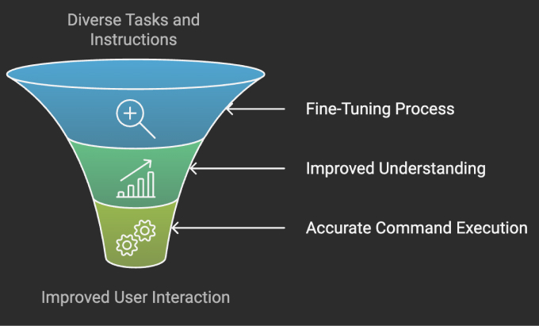
Instruction Finetuning (IFT)
Given Ignite’s data-rich and specialized threat-intel environment, the ideal fine-tuning approach is a Hybrid Fine-Tuning + Instruction Tuning strategy.
Instruction tuning involves further training LLMs on datasets comprising (instruction, output) pairs, enabling models to better align with human instructions across diverse tasks. While traditional fine-tuning methods rely on generic datasets, instruction fine-tuning focuses on training models to align their outputs with user-provided instructions across a diverse set of tasks.
source: https://www.deepchecks.com/glossary/instruction-tuning/

Slide 20
Ariadne: Graph Model
Mitigation
Intelligence
Wazuh
Ruleset
Detection
Intelligence
ATT&CK Mitigations
ET
Ruleset
MITRE D3FEND
MITRE ATT&CK
Flashpoint
MITRE CAPEC
CISA KEV
MITRE CWE
CISA CVE
EPSS
Severity
Intelligence
CVSS
Vulnerability
Intelligence

Slide 21
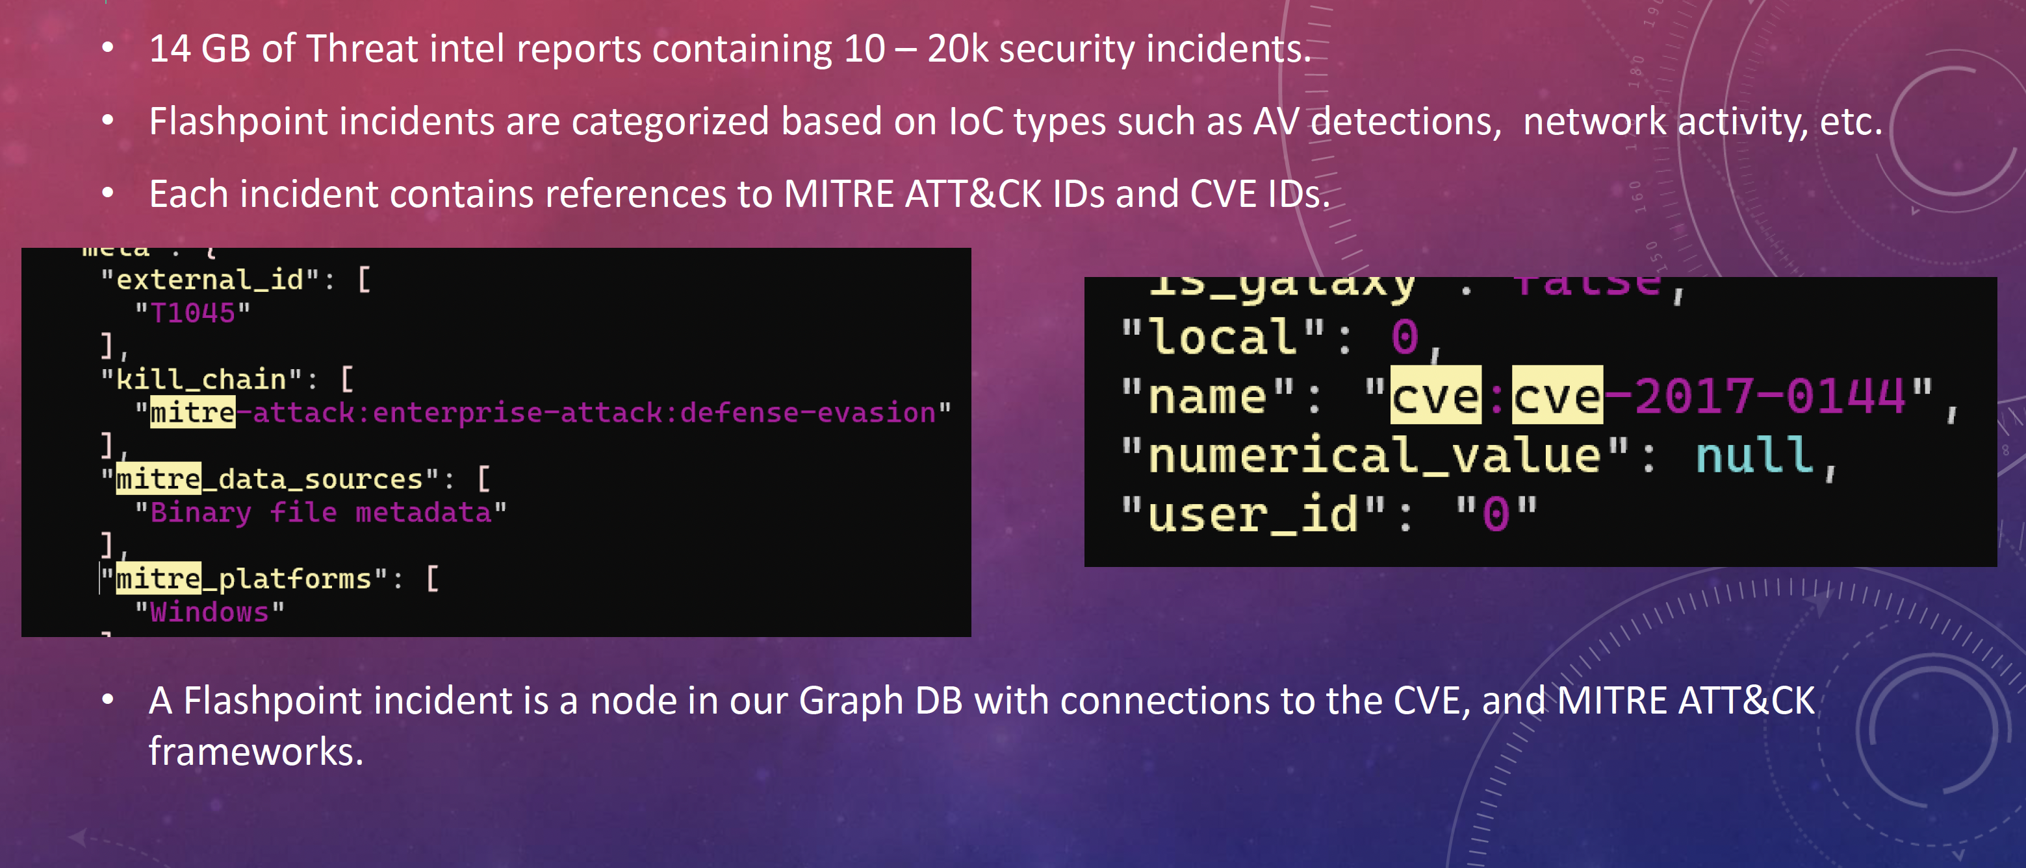
Flashpoint Ignite Data

Slide 22
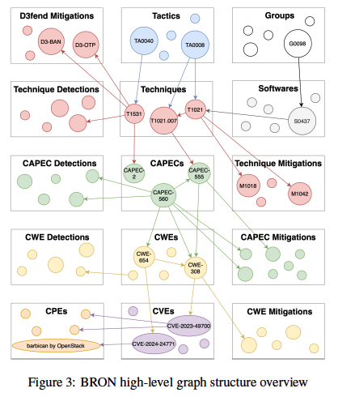
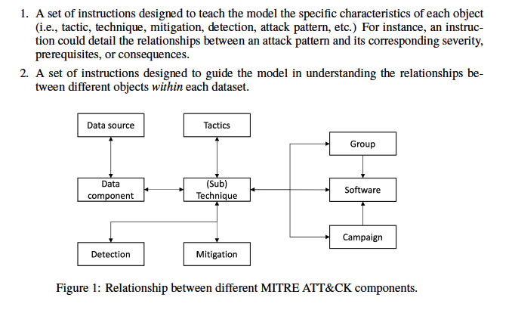
Athena-CTI-LLM IFT Design
Given Ignite’s data-rich and specialized threat-intel environment, the ideal fine-tuning approach is a Hybrid Fine-Tuning + Instruction Tuning strategy.
source: CyberPal.AI: Empowering LLMs with Expert-Driven CyberSecurity Instructions; Levi et al Aug 2024

Slide 23

Athena-CTI-LLM Product Lifecycle

Slide 24
Mapping CTI-Bench Tasks to Use Cases
Use Cases
CTI-Bench Tasks
Summarize incoming threat reports
Report Summarization (ROUGE score)
Extract IOCs from alerts/reports
IOC Extraction (F1 score)
Identify ATT&CK techniques used
TTP Identification (F1/Accuracy)
Answer analyst questions about threats
Question Answering (Accuracy/F1)
The chosen benchmark suite (e.g., CTI-Bench) should contain tasks that directly map to the intended use cases of the LLM within the platform.
Define "good enough" performance thresholds (e.g., F1 > 0.80 for IOC Extraction, Accuracy > 0.75 for TTP Identification) based on operational requirements and baseline performance. These thresholds determine if a model version is suitable for deployment.
Ensure the benchmark covers the critical capabilities expected from the LLM in production. If existing benchmarks lack coverage for specific use cases, custom evaluation tasks may need to be developed.

Slide 25
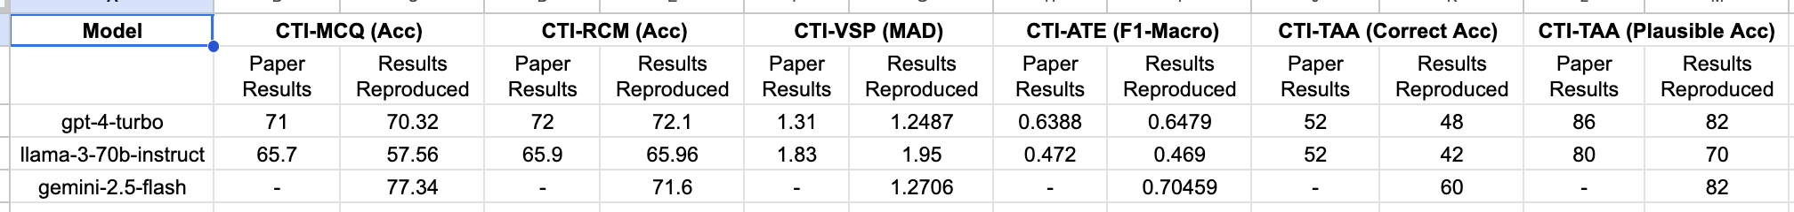
CTIBench v1.0
[Working on Athena-CTI-Bench: Q4 ‘25 delivery]
Abstract:
Cyber threat intelligence (CTI) is crucial in today's cybersecurity landscape, providing essential insights to understand and mitigate the ever-evolving cyber threats. The recent rise of Large Language Models (LLMs) have shown potential in this domain, but concerns about their reliability, accuracy, and hallucinations persist. While existing benchmarks provide general evaluations of LLMs, there are no benchmarks that address the practical and applied aspects of CTI-specific tasks. To bridge this gap, we introduce CTIBench, a benchmark designed to assess LLMs' performance in CTI applications. CTIBench includes multiple datasets focused on evaluating knowledge acquired by LLMs in the cyber-threat landscape. Our evaluation of several state-of-the-art models on these tasks provides insights into their strengths and weaknesses in CTI contexts, contributing to a better understanding of LLM capabilities in CTI.
CTI-MCQ (Acc): Multiple-choice question answering on CTI concepts, measured by accuracy.
CTI-RCM (Acc): Response classification matching task, evaluated by accuracy.
CTI-VSP (MAD): Vulnerability severity prediction, assessed using Mean Absolute Deviation (MAD).
CTI-ATE (F1-Macro): Adversary technique extraction, scored with macro-averaged F1.
CTIBench: A Benchmark for Evaluating LLMs in Cyber Threat Intelligence; Alam et al, Nov 2024

Slide 26
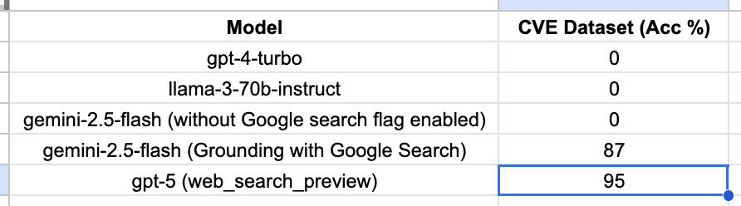
Will include Capabilities around measurement of trailing last 90 days of CTI data…
Last 90 Days
Tests last 90 day CTI info, most critical aspect of CTI landscape for security professionals. Test last 90 days of vulnerabilities and exploits.
If using the larger providers, search must be enabled…

Slide 27
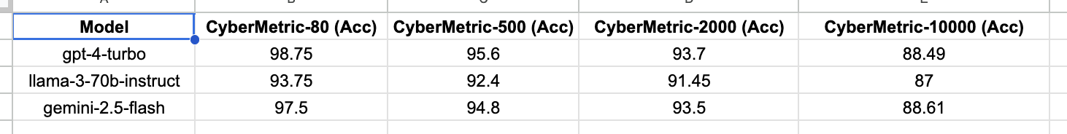
CyberMetric:
Additional CTI Benchmarking
Abstract:
... To accurately test the general knowledge of LLMs in cybersecurity, the research community needs a diverse, accurate, and up-to-date dataset. To address this gap, we present CyberMetric-80, CyberMetric-500, CyberMetric-2000, and CyberMetric-10000, which are multiple-choice Q&A benchmark datasets comprising 80, 500, 2000, and 10,000 questions respectively. By utilizing GPT-3.5 and Retrieval-Augmented Generation (RAG), we collected documents, including NIST standards, research papers, publicly accessible books, RFCs, and other publications in the cybersecurity domain, to generate questions, each with four possible answers. The results underwent several rounds of error checking and refinement. Human experts invested over 200 hours validating the questions and solutions to ensure their accuracy and relevance, and to filter out any questions unrelated to cybersecurity. We have evaluated and compared 25 state-of-the-art LLM models on the CyberMetric datasets. In addition to our primary goal of evaluating LLMs, we involved 30 human participants to solve CyberMetric-80 in a closed-book scenario. The results can serve as a reference for comparing the general cybersecurity knowledge of humans and LLMs. The findings revealed that GPT-4o, GPT-4-turbo, Mixtral-8x7B-Instruct, Falcon-180B-Chat, and GEMINI-pro 1.0 were the best-performing LLMs. Additionally, the top LLMs were more accurate than humans on CyberMetric-80, although highly experienced human experts still outperformed small models such as Llama-3-8B, Phi-2 or Gemma-7b.
CyberMetric: A Benchmark Dataset based on Retrieval-Augmented Generation for Evaluating LLMs in Cybersecurity Knowledge; Tihanyi et al, June 2024

Slide 28
Natural Language Understanding Benchmarks
Avoiding hallucinations (where is the bottom threshold on model size…)
GLUE – General Language Understanding Evaluation
Introduced in 2018, GLUE is a multi‑task benchmark designed to assess foundational natural language understanding capabilities. It combines nine diverse tasks—such as sentiment analysis, textual similarity, entailment, and linguistic acceptability—into a unified evaluation framework, and includes a hand‑crafted diagnostic suite for analyzing model weaknesses.
SuperGLUE – A Stickier Benchmark for General-Purpose Language Understanding
Debuted in 2019 as a more challenging successor to GLUE, SuperGLUE comprises eight higher‑difficulty tasks, including advanced reading comprehension, natural language inference, coreference resolution, and question answering. It also sets a stronger human baseline and includes an integrated toolkit and public leaderboard.

Slide 29
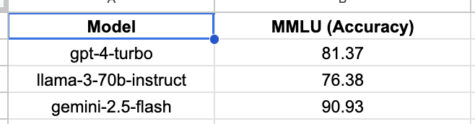
NLU Benchmarks (CONT): MMLU
MMLU – Measuring Massive Multitask Language Understanding
MMLU raises the bar significantly with: 57 subject domains, ranging from STEM and humanities to professional fields like medicine, law, ethics, and philosophy. Over 15,900 multiple-choice questions in total, drawn from undergraduate to professional levels; about 1,540 questions are reserved for tuning model settings like temperature or learning rate. A focus on zero‑ or few‑shot evaluation, testing models’ generalization without extensive fine-tuning on task-specific data.

Slide 30
AthenaBench CTI Test Subject Areas
The Athena Benchmark systematically assessed leading language models across six (6) key Cyber Threat Intelligence (CTI) and tasks:
    Athena-ATE (Attack Technique Enumeration) - Metric: Accuracy
    Athena-RCM (Root Cause Mapping) – Metric: Accuracy
    Athena-RMS (Risk Mitigation Strategy) – Metric: F1 Score
    Athena-MCQ (Multiple Choice Question) – Metric: Accuracy
    Athena-VSP (CVSS Vector Severity Prediction) – Metric: Average
    Athena-TAA (Threat Actor Attribution) – Metric: Accuracy (threefold)

Slide 31
Model | Athena-ATE (Accuracy) | Athena-RCM (Accuracy) | Athena-RMS (F1-score) | Athena-MCQ (Accuracy) | Athena-VSP (Average Score) | Athena-TAA
 | ATE: Attack Technique Enumeration | RCM: Root Cause Mapping | RMS: Risk Mitigation Strategy | MCQ: Multiple Choice Questions | VSP: CVSS Vector Severity Prediction | TAA: Threat Actor Attribution
 |  |  |  |  |  | Correct Accuracy | Plausible Accuracy | Combined Accuracy
GPT-OSS-20B | 0.258 | 0.5895 | 0.03 | 0.6686 | 1.4122 | 0.04 | 0.09 | 0.065
GPT-4 | 0.358 | 0.6305 | 0.1505 | 0.787 | 1.1762 | 0.31 | 0.87 | 0.59
GPT-4o | 0.516 | 0.713 | 0.2019 | 0.852 | 1.176 | 0.35 | 0.87 | 0.61
GPT-4-Turbo | 0.488 | 0.646 | 0.218 | 0.819 | 1.538 | 0.29 | 0.9 | 0.595
GPT-5 | 0.76 | 0.716 | 0.3259 | 0.92 | 1.123 | 0.39 | 0.83 | 0.61
Gemini-2.5-pro | 0.762 | 0.712 | 0.2843 | 0.891 | 1.1218 | 0.31 | 0.81 | 0.56
Gemini-2.5-flash | 0.516 | 0.651 | 0.1344 | 0.792 | 1.66 | 0.3 | 0.86 | 0.58
Qwen3-4B | 0.056 | 0.4535 | 0.0481 | 0.698 | 1.5709 | 0.15 | 0.91 | 0.53
Qwen3-8b | 0.056 | 0.244 | 0.0193 | 0.256 | 1.9607 | 0 | 0.01 | 0.05
Qwen3-14B | 0.154 | 0.4355 | 0.03024 | 0.5449 | 1.2353 | 0.05 | 0.14 | 0.095
Llama 3.1-8B | 0.164 | 0.4277 | 0.03614 | 0.6749 | 2.008 | 0.24 | 0.83 | 0.535
Llama-Primus-Merged (8B) | 0.248 | 0.451 | 0.0017 | 0.1963 | 1.8575 | 0.02 | 0.12 | 0.07
Llama 3-70b-Instruct | 0.316 | 0.5665 | 0.11076 | 0.7893 | 2.7869 | 0.22 | 0.83 | 0.525
Llama 3.3-70b-Instruct | 0.304 | 0.6 | 0.1112 | 0.7597 | 2.2992 | 0.26 | 0.89 | 0.575

Slide 32
Model Comparisons: Proprietary vs. Open-Source
Proprietary Models (OpenAI GPT & Google Gemini)
GPT-5 and Gemini-2.5-Pro consistently achieved the highest aggregated performance across all Athena tasks.
GPT-5 demonstrated outstanding precision and contextual reasoning in multi-stage CTI analysis and threat mapping.
Gemini-2.5-Pro maintained near-identical results with remarkable task consistency, indicating strong stability and cross-domain generalization.
GPT-4o performed on par with the top models in reasoning-driven benchmarks such as Athena RCM, MCQ, and TAA, showing exceptional reliability and adaptability.
Hugging Face Models
Llama-3.3-70B-Instruct continues to be the benchmark open-weight baseline, offering consistent performance on Athena RCM and MCQ tasks.
Qwen3-14B displayed competent reasoning ability with balanced MCQ and attribution scores, outperforming smaller variants like Qwen3-4B.
GPT-OSS-20B exhibited moderate generalization in Athena RCM and MCQ tasks, making it promising for controlled-compute environments.
Llama-Primus-Merged (8B), trailed the larger open models but remains viable for lightweight fine-tuning and inference pipelines where cost and model footprint are primary considerations.
Qwen3-4B, while limited in analytical reasoning, maintained reliable factual QA accuracy, making it suitable for simpler classification or knowledge-retrieval subtasks.

Slide 33
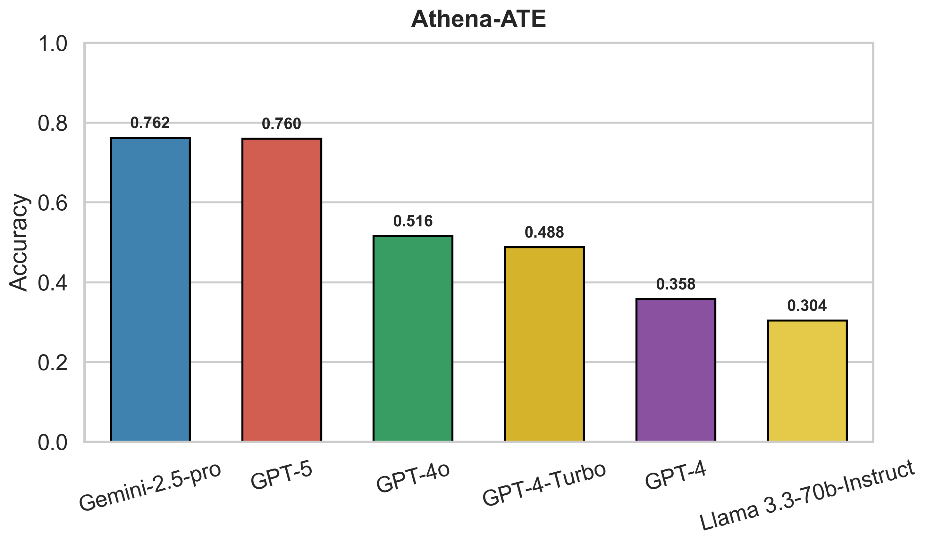
ATE: Attack Technique Enumeration
Evaluation Metric: Accuracy of
Identifying MITRE Attack Techniques
GPT-5 and Gemini-2.5-pro lead are top performers

Slide 34
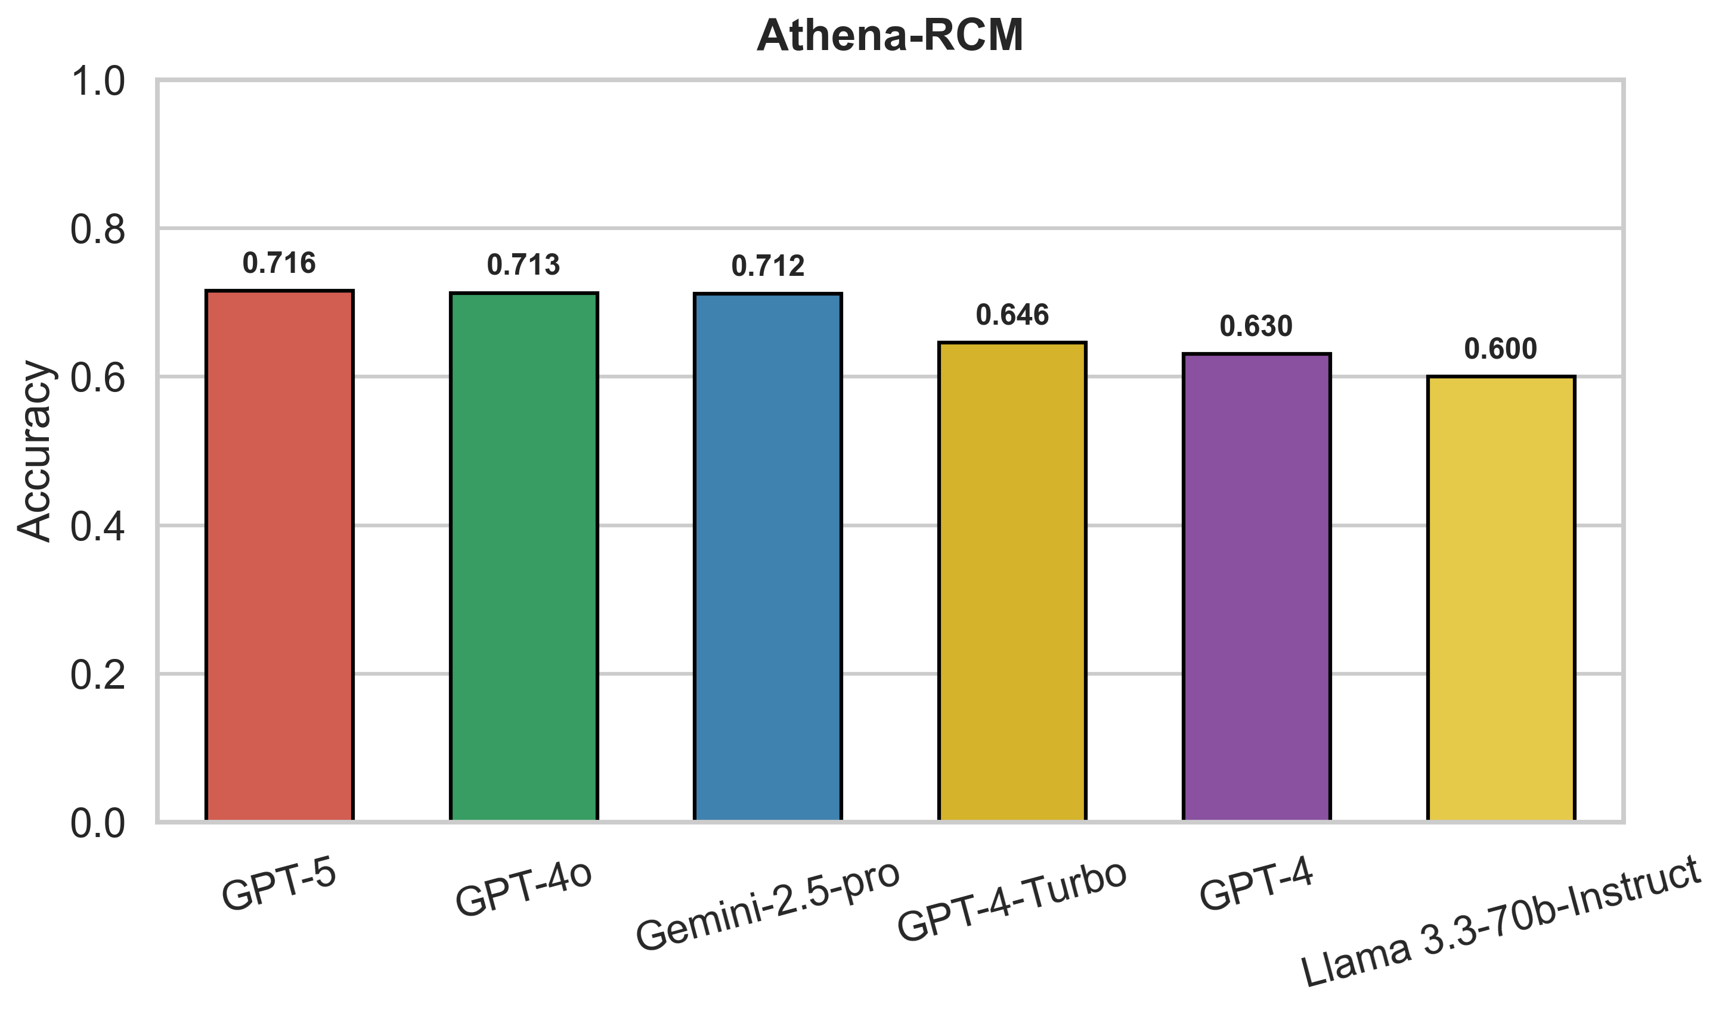
RCM: Root Cause Mapping
Evaluation Metric: Accuracy.
GPT-5, Gemini-2.5-pro, and GPT-4o lead excel in casual mapping.

Slide 35
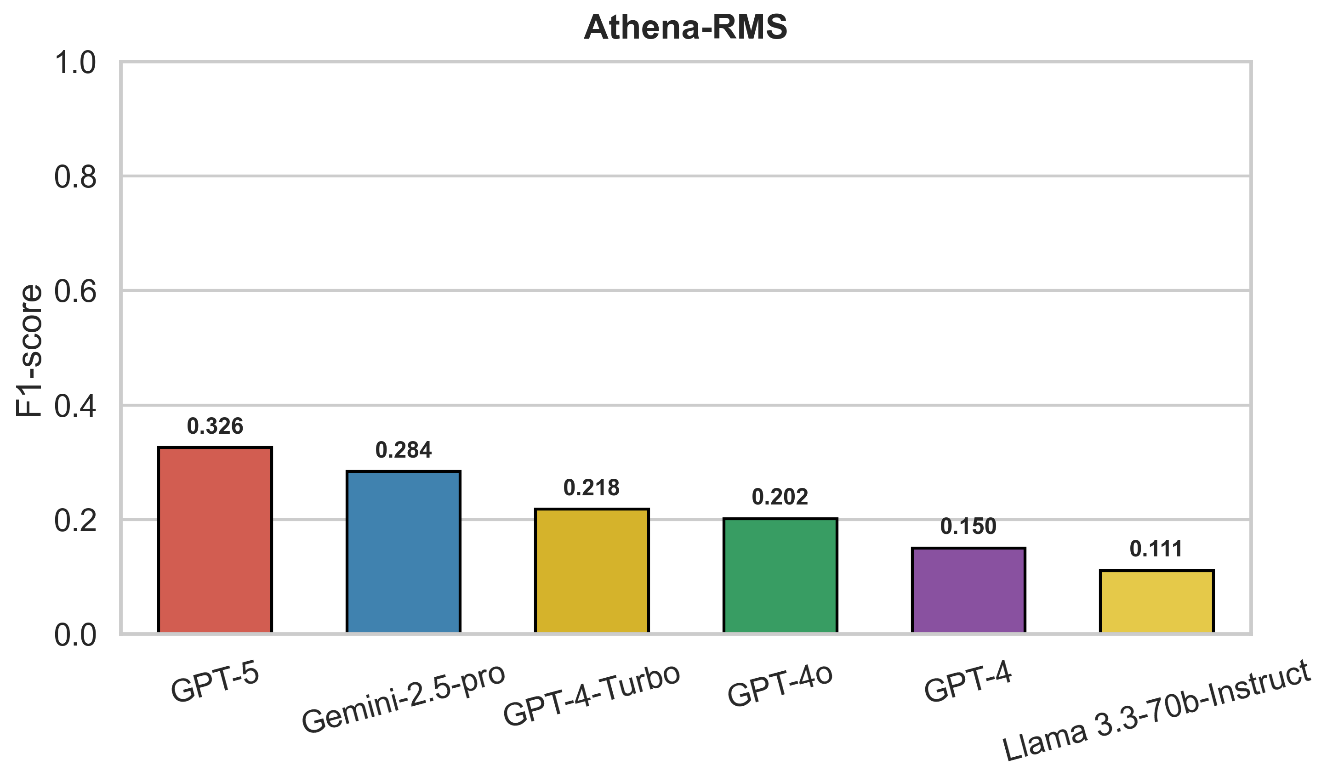
RMS: Risk Mitigation Strategy
Evaluation Metric: F1-score
GPT-5, Gemini-2.5-pro, and GPT-4-turbo are top performers.

Slide 36
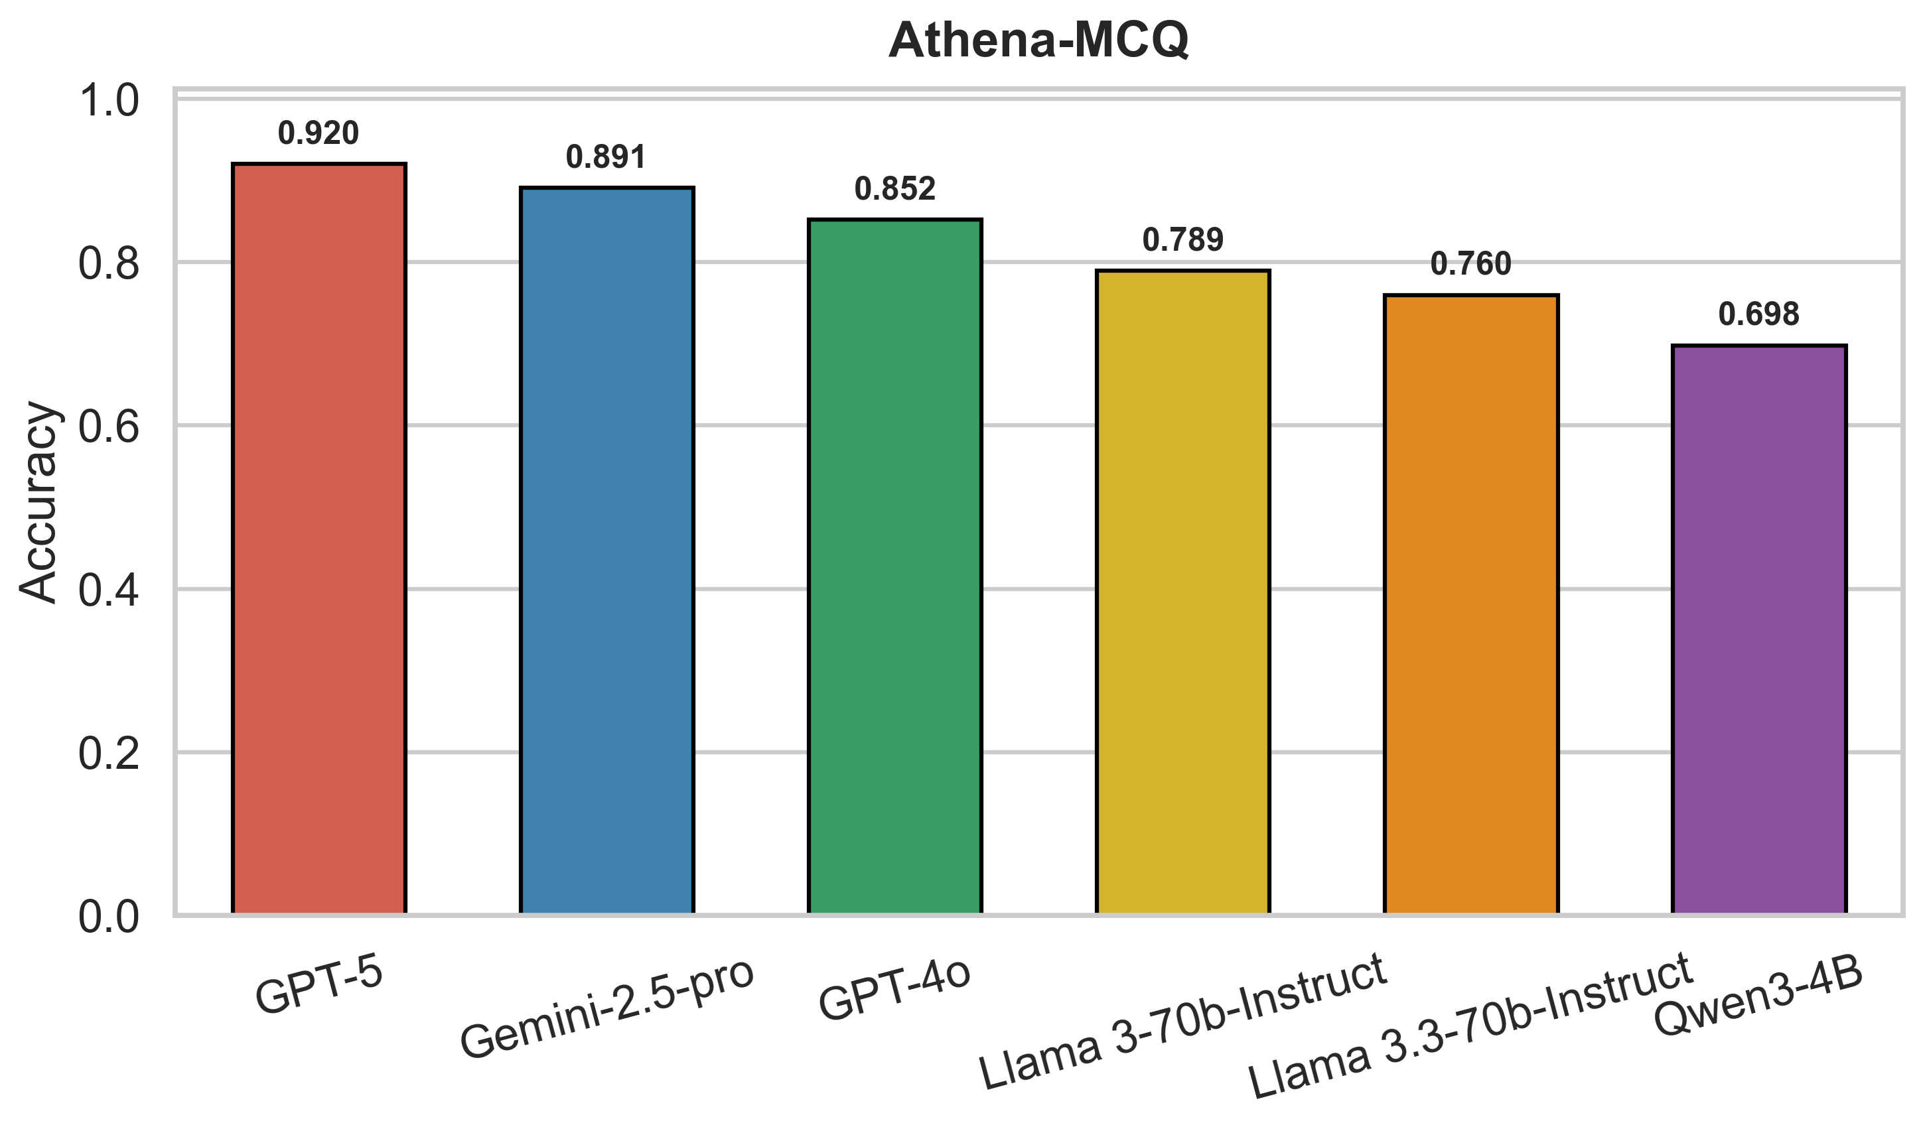
MCQ: Multiple Choice Questions
Evaluation Metric: F1-score
GPT-5 and Gemini-2.5-pro are top performers.

Slide 37
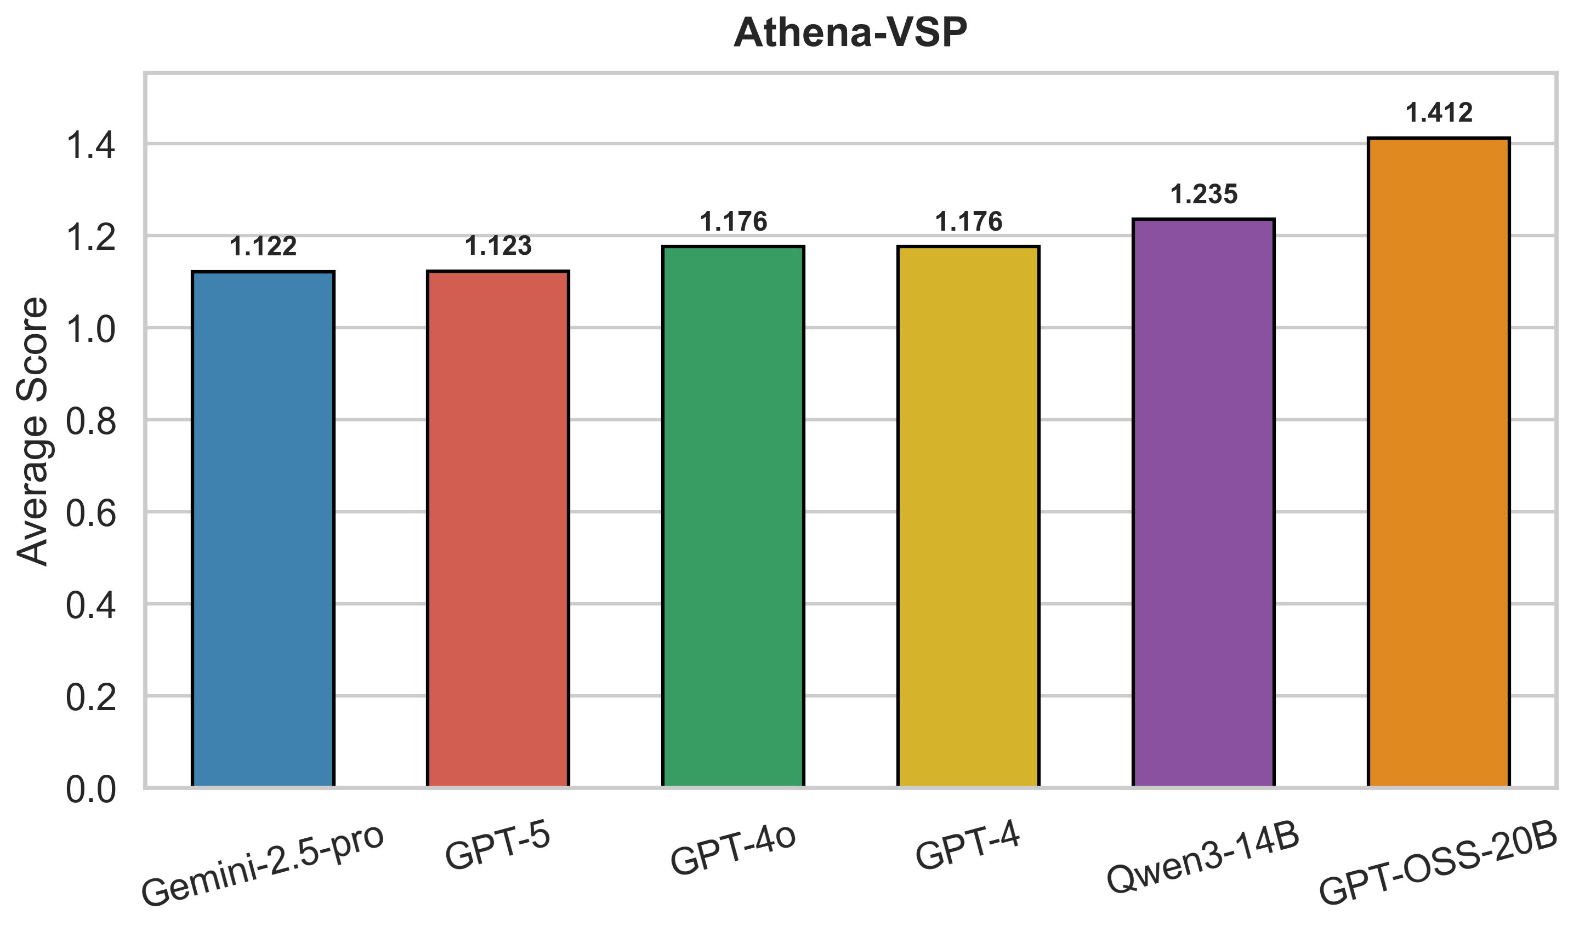
VSP: CVSS Vector Severity Prediction
Evaluation Metric: Average Deviation from correct CVSS score
GPT-5, Gemini-2.5-pro achieve minimal error.

Slide 38
TAA: Threat Actor Attribution
Model | Correct Accuracy | Plausible Accuracy | Combined Accuracy
GPT-5 | 0.39 | 0.83 | 0.61
GPT-4o | 0.35 | 0.87 | 0.61
GPT-4-Turbo | 0.29 | 0.90 | 0.595
Gemini-2.5-Pro | 0.31 | 0.81 | 0.56
Qwen3-4B | 0.15 | 0.91 | 0.53
Evaluation Metric: Accuracy
GPT-5, GPT-4o best overall scores

Slide 39
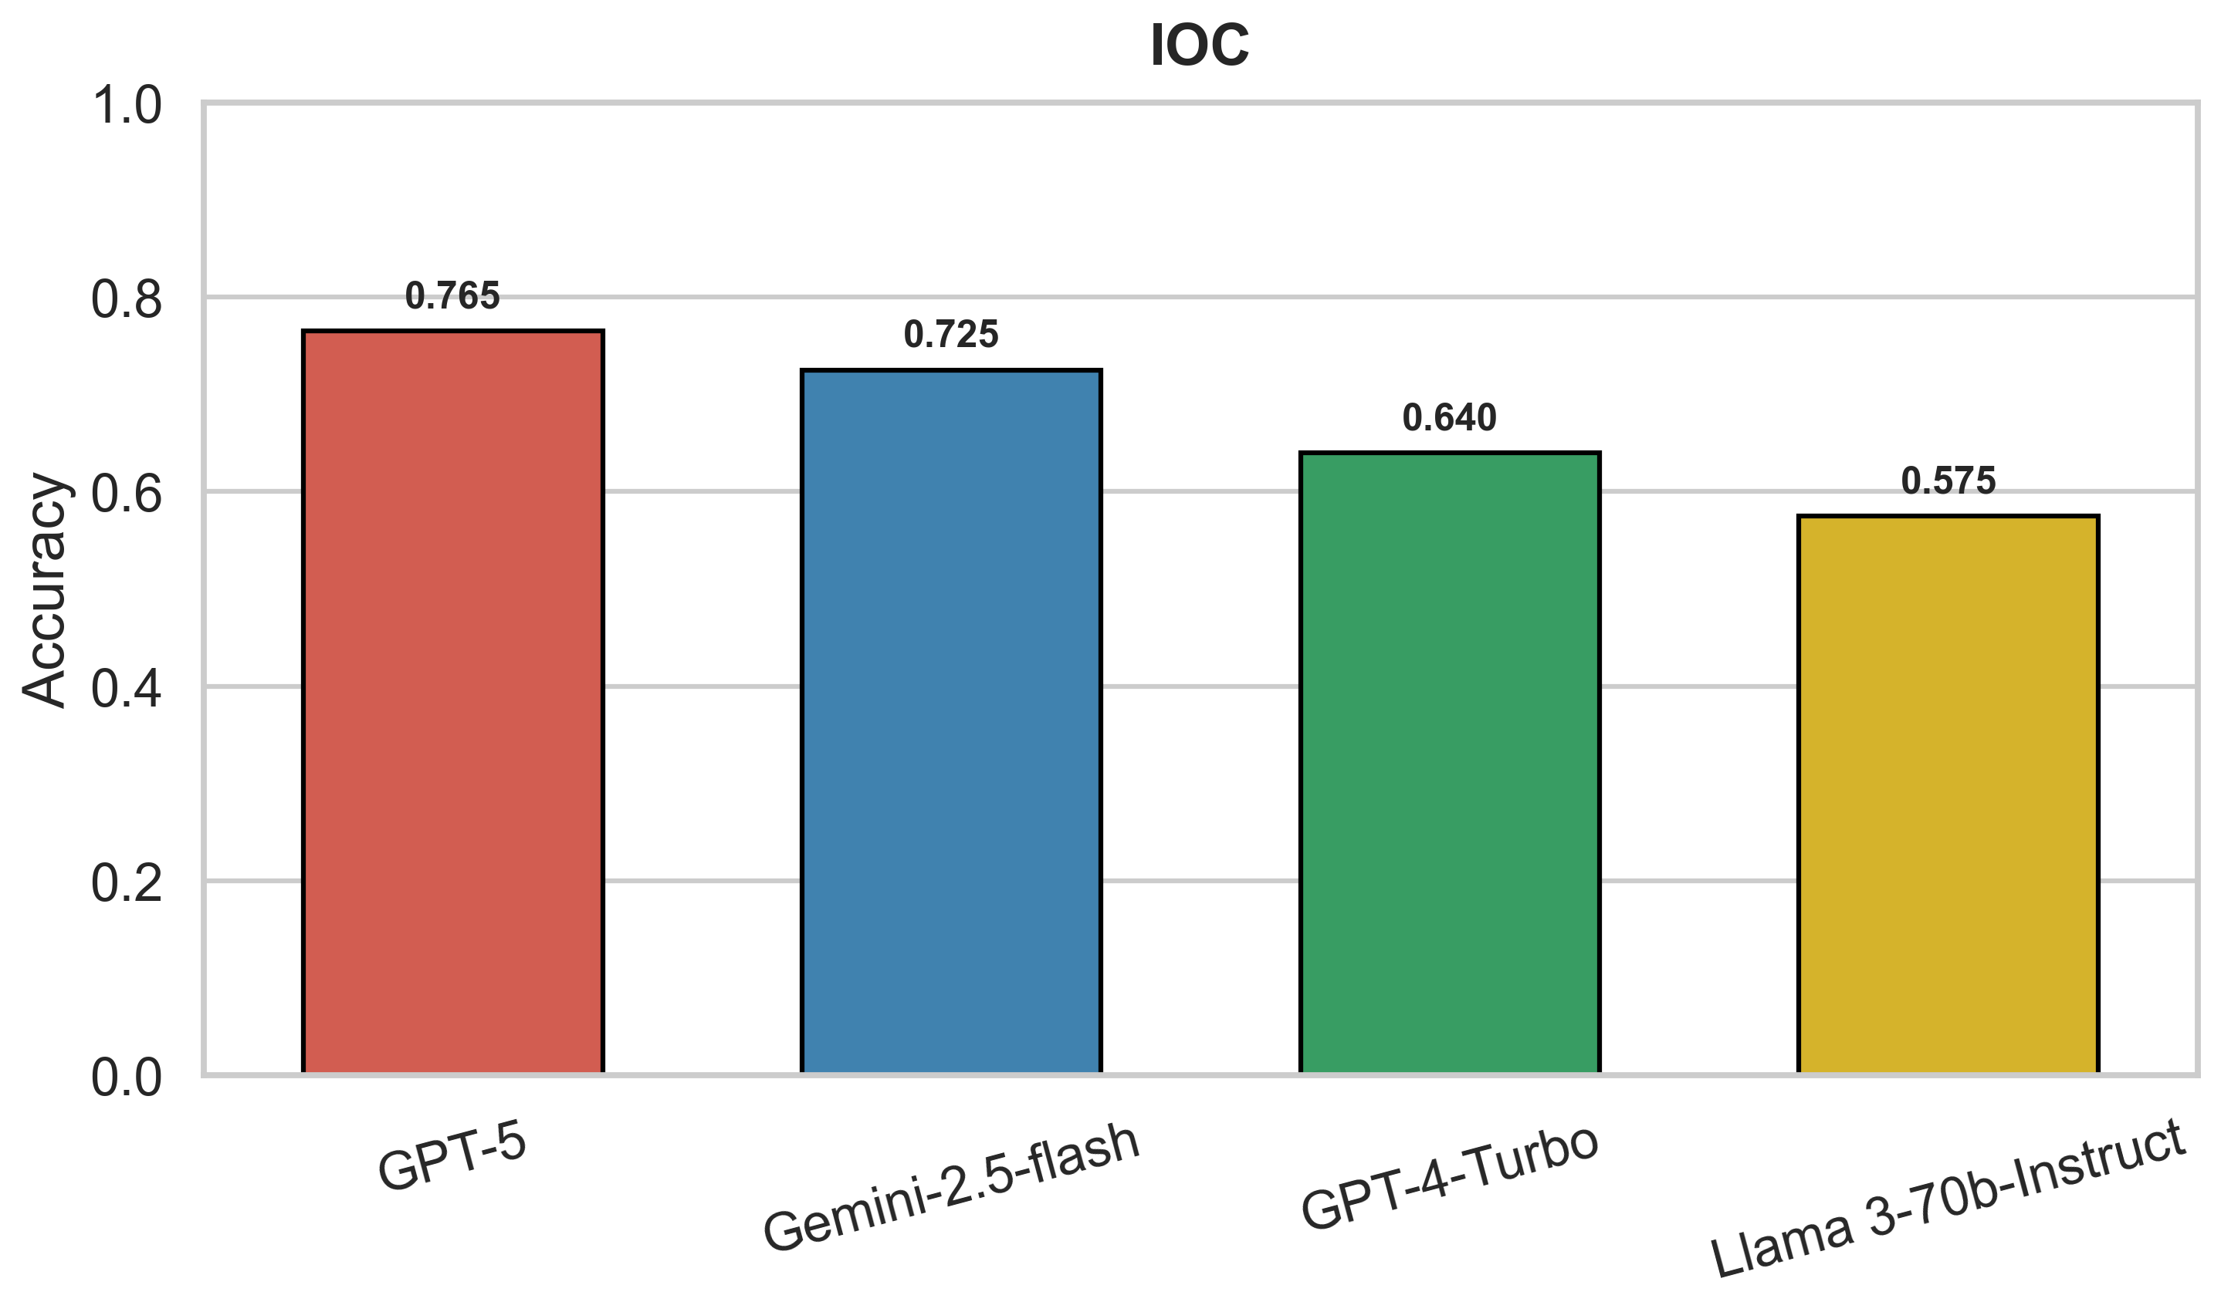
IOC (Indicator of Compromise) Prediction
Evaluation Metric: Accuracy
GPT-5 and Gemini-2.5-flash performed best in this category

Slide 40
Athena CTI-LND
Latest 90 days CVEs fetched from NVD NIST.
Random 10% CVEs selected for evaluation.
LLM predicts CVE-ID from description.
LLMs are unable to predict CVE-IDs because of their knowledge cutoff.
GPT-5 with web search preview enabled achieves 95% accuracy.
Gemini-2.5-flash with Google search reaches 87% accuracy.
Demonstrates web search integration as a performance booster.
Established GPT-5 as the current top performer.

Slide 41
Summary Value Proposition
Industry Fragmentation yields opportunity with Integrated Approach
Consolidated and normalized threat identification across the entire network infrastructure (Firewall, WAF, SIEM, NIDS, EDR)
Build and train CTI-LLM using state of the art threat intelligence (Flashpoint’s Ignite)
RAG based integration into CTI-LLM for automated contextualized responses
Yield better outcomes both in terms of threat detection and response, a necessary condition for Cyber Defense in the age of AI

Slide 42

Athena Software Group
Best in Class, AI Enabled, security solutions for Enterprise application providers.

